Slide 1

WiDS Datathon 2025
Unraveling the Mysteries of the Female Brain: Sex Patterns in ADHD
Group members:
Mushaer Ahmed Neha Chaudhari Partha Vemuri Pooja Pandit

Slide 2
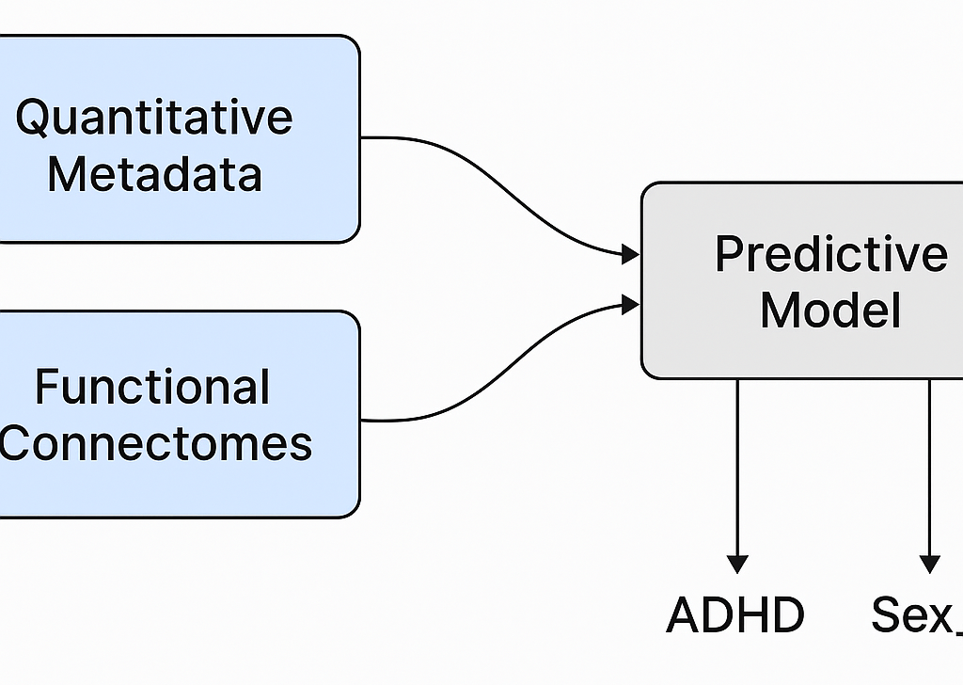
Introduction
WiDS Datathon 2025: Predicting Sex and ADHD Diagnosis Using fMRI Data
Predict an individual's sex
Predict an individual's ADHD diagnosis
This challenge provides a unique opportunity to develop advanced ML models, drive impact in brain health research and collaborate across disciplines

Slide 3
Introduction
🧠 Understanding the Brain Through Data
The Mission Behind the WiDS Datathon Challenge:
Developed in collaboration with Cornell University, UC Santa Barbara, the Child Mind Institute’s Healthy Brain Network (HBN), and the Reproducible Brain Charts (RBC) project
Focus: Sex-based differences in neurodevelopmental disorders, particularly ADHD
ADHD affects ~14% of boys and ~8% of girls — but girls are often underdiagnosed due to subtle, inattentive symptoms
Early, accurate diagnosis is key to improving mental health outcomes and long-term quality of life
🎯 Challenge Objectives
What brain activity patterns are associated with ADHD, and do they differ between males and females?
Create a multi-outcome model to predict two separate target variables:
ADHD (1=yes or 0=no)
female (1=yes or 0=no)

Slide 4
Training datasets
Categorical Metadata – Key Details
Participants: 1,213
Columns: 10
Content: Demographic and family background
The training data consists of three distinct components:
Dataset | Description
Categorical Metadata | Demographic and socioeconomic details about each participant (10 features)
Quantitative Metadata | Clinical or psychological scores such as IQ, behavioral ratings, etc.
Functional Connectome | Brain connectivity data derived from fMRI scans (high-dimensional)
Column Name | Description
participant_id | Unique ID for each participant
Basic_Demos_Enroll_Year | Year of enrollment (e.g., 2017–2019)
Basic_Demos_Study_Site | Location/site of data collection
PreInt_Demos_Fam_Child_Ethnicity | Ethnicity of the child
PreInt_Demos_Fam_Child_Race | Race of the child
MRI_Track_Scan_Location | MRI scan location
Barratt_Barratt_P1_Edu | Parent 1 education score (Barratt scale)
Barratt_Barratt_P1_Occ | Parent 1 occupation score
Barratt_Barratt_P2_Edu | Parent 2 education score (or missing)
Barratt_Barratt_P2_Occ | Parent 2 occupation score (or missing)

Slide 5
Training datasets
Column Name | Description
participant_id | Unique ID for each participant
EHQ_EHQ_Total | Total score from the Eating Habits Questionnaire
ColorVision_CV_Score | Color vision assessment score
APQ_P_* | Subscales from the Alabama Parenting Questionnaire (e.g., involvement, discipline)
SDQ_* | Subscales from the Strengths and Difficulties Questionnaire (e.g., emotional symptoms, hyperactivity)
MRI_Track_Age_at_Scan | Age of participant at time of MRI scan (in years)
Quantitative Metadata – Structured Behavioral Measures
Participants: 1,213
Features: 19 columns
Content: Psychometric, behavioral, and age-based quantitative scores
Identifier: participant_id

Slide 6
Training datasets
Functional connectome matrices – fMRI-based brain connectivity
Participants: 758
Features: 3,585 columns
Content: Pairwise Pearson correlation values between brain regions
Format: Dense matrix per participant (1 row = 1 brain connectivity profile)
🧬 Description
Contains functional connectivity matrices derived from resting-state fMRI scans, where:
Each feature represents the Pearson correlation between activity in two distinct brain regions
A total of 3,585 unique region pairs are computed per participant
The matrix encodes how synchronized different brain areas are — a key signal for detecting neurodevelopmental traits
📈 Purpose in Modeling
Used to identify biomarkers of ADHD or sex differences in brain connectivity
Provides high-dimensional features essential for model training alongside metadata

Slide 7
Test datasets
Column Name | Description
participant_id | Unique ID for each test participant
Basic_Demos_Enroll_Year | Year of enrollment in the study
Basic_Demos_Study_Site | Identifier for site/location of data collection
PreInt_Demos_Fam_Child_Ethnicity | Ethnicity of the participant
PreInt_Demos_Fam_Child_Race | Race of the participant
MRI_Track_Scan_Location | Location where MRI was conducted
Barratt_Barratt_P1_Edu | Parent 1 education score (Barratt scale)
Barratt_Barratt_P1_Occ | Parent 1 occupation score
Barratt_Barratt_P2_Edu | Parent 2 education score
Barratt_Barratt_P2_Occ | Parent 2 occupation score
Test Data – Categorical Metadata Overview
Participants: 304
Features: 10 categorical columns
Purpose: Demographic and background information used for model inference
Identifier: participant_id

Slide 8
Test datasets
Column Name | Description
participant_id | Unique ID for each test participant
EHQ_EHQ_Total | Total score from the Eating Habits Questionnaire
ColorVision_CV_Score | Color vision assessment score
APQ_P_* | Subscales from the Alabama Parenting Questionnaire (e.g., parental involvement, discipline)
SDQ_* | Subscales from the Strengths and Difficulties Questionnaire (e.g., emotional symptoms, peer problems)
MRI_Track_Age_at_Scan | Age of the participant at time of MRI scan (in years)
Test Data – Quantitative Metadata Summary
Participants: 304
Features: 19 numeric columns
Purpose: Behavioral, psychological, and age-related measures for prediction
Identifier: participant_id

Slide 9
Test datasets
Test Data – Functional Connectome Matrices
Participants: 304
Features: 19,901 continuous columns
Type: Pearson correlation values between fMRI time-series of brain region pairs
Value Range: Approximately from –4 to +2 (Z-score normalized)
🧬 Description
This dataset contains functional connectome matrices derived from fMRI scans, where:
Each feature represents the functional connectivity between two brain regions for a given individual
Values are continuous and represent Z-transformed Pearson correlations
The data encodes how synchronized the activity is across brain regions — a key neurobiological signal
📈 Role in Prediction
Provides rich, high-dimensional input for predicting ADHD and Sex_F using machine learning
Captures network-level brain activity patterns that may reflect neurodevelopmental differences

Slide 10

Identified Challenges
1. High Dimensionality:
Functional connectivity features are numerous and dense
2. Multi-output Binary Classification:
One model must handle two outputs simultaneously
3. Data Merging & Preprocessing:
Requires careful merging and standardization
4. Beginner Team:
First-time global challenge experience

Slide 11
Data Preprocessing
Handling Missing Data in Categorical Data
Imputation of Categorical Features using Mode
Why Imputation was Needed: Several categorical columns had missing entries some with significant amount and we could not risk dropping many participants/rows.
Method Used:
Each column was filled with its mode (most frequent value).
Mode imputation is ideal for categorical data as it:
Being a numeric data type is still categorical in nature.
Preserves data integrity.
Prevents introducing unknown or synthetic categories.
Avoids assumptions of order or distribution.

Slide 12
Data Preprocessing
Handling Missing Data in Quantitative Data
Imputation of Quantitative Features using KNN Imputation
Why Imputation was Needed: Several columns had missing entries some with significant amount and we could not risk dropping a large number of participants/rows.
Why KNN Imputer?
Quantitative data may contain patterns or correlations across features.
KNN captures multivariate relationships, making it more suitable for complex or correlated datasets.
For each missing value, the algorithm finds the 5 nearest neighbors and imputes using the average of those neighbors.

Slide 13
Data Preprocessing
Dataset Integration & Cleaning
Final step was to merge and cleanup the dataset
Datasets Used:
Categorical Metadata
Quantitative Metadata
Connectome Matrices
Train data(ADHD, Sex)
Steps taken to merge :
Merged on the participant_id column as it was common throughout all datasets.
Final rows with any remaining missing values were dropped.

Slide 14
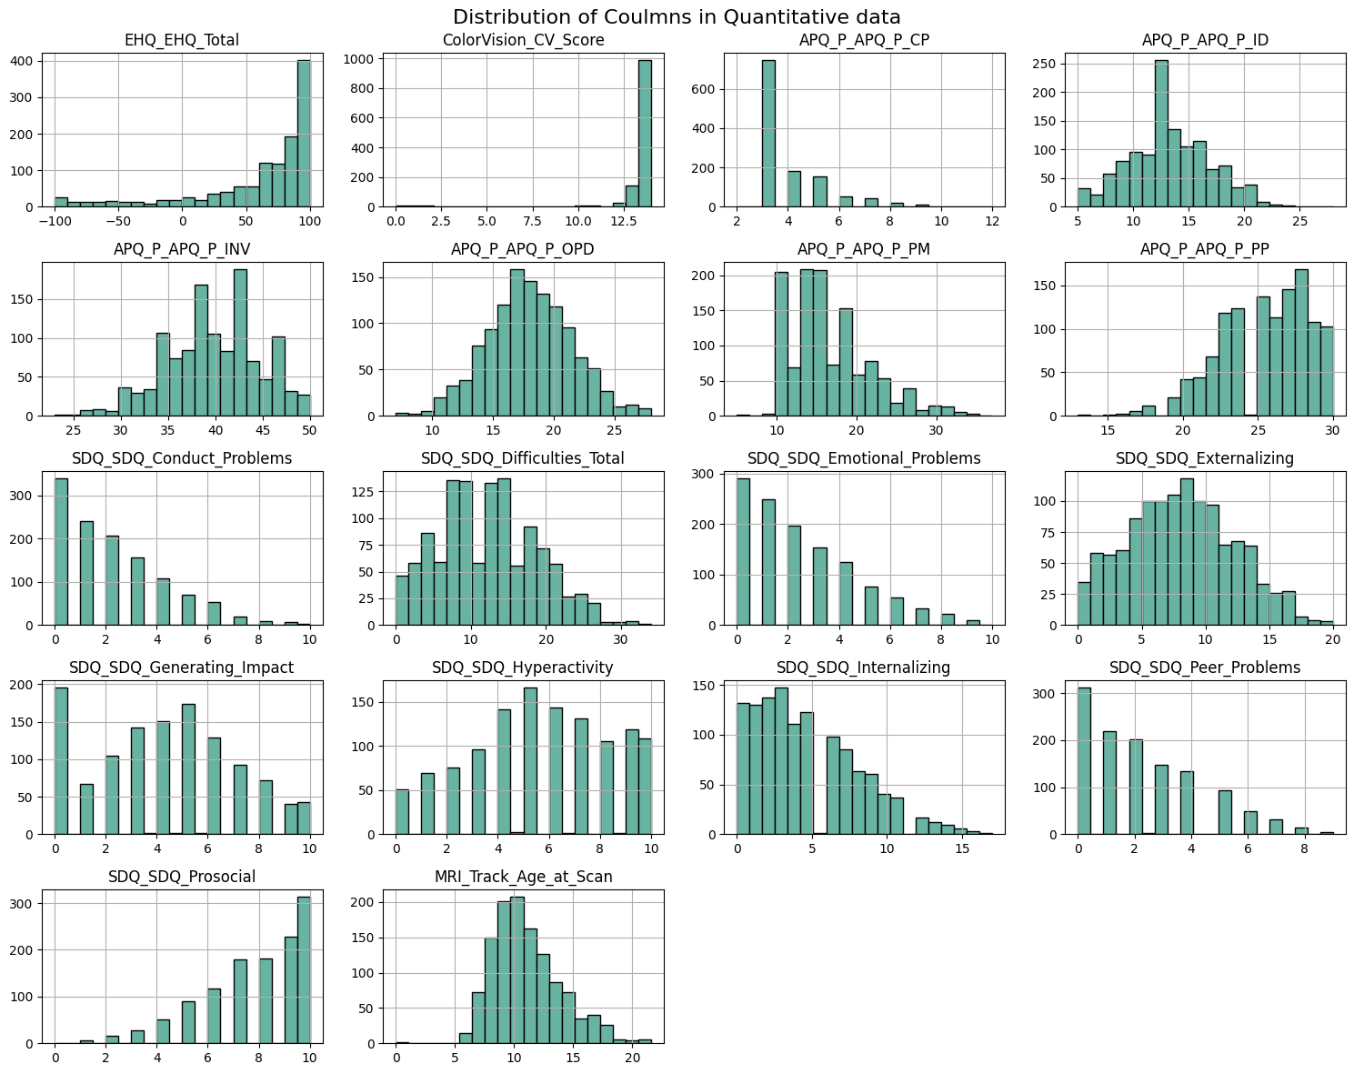
Exploratory Data Analysis 1. Distribution of Columns in Quantitative data

Slide 15
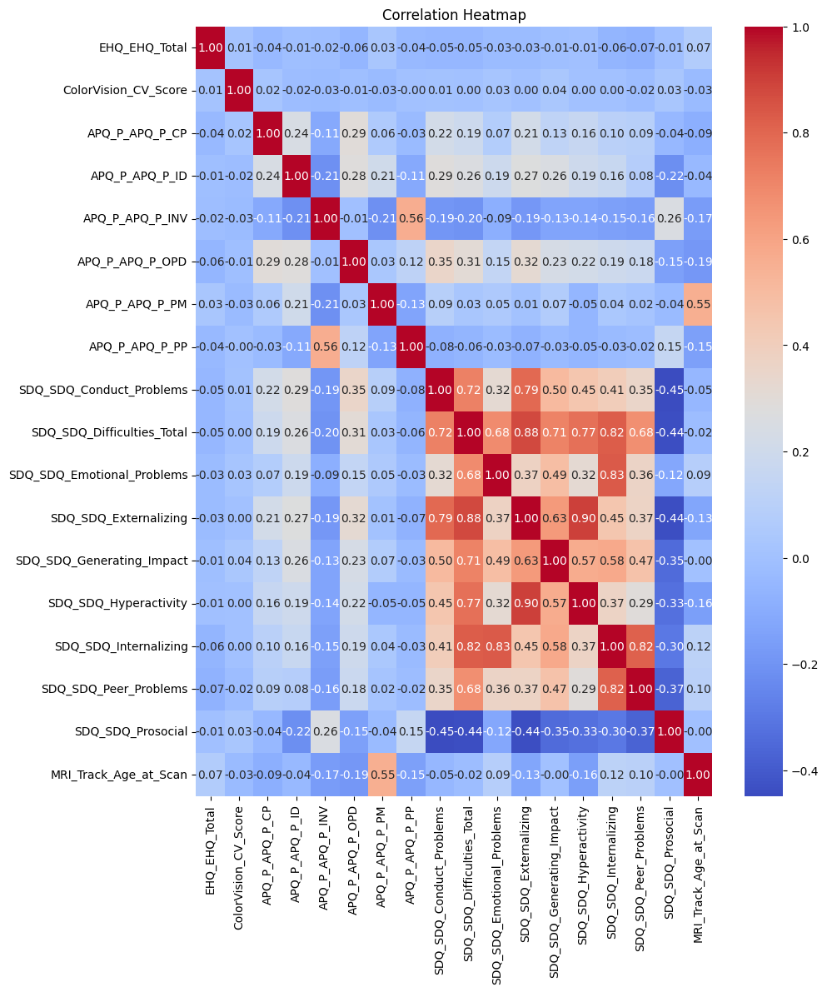
Exploratory Data Analysis 2. Correlation Heatmap (Quantitative Data)
To check multicollinearity, which can affect model stability. Also helps identify feature groups with strong relationships to each other (and potentially to ADHD or sex).

Slide 16
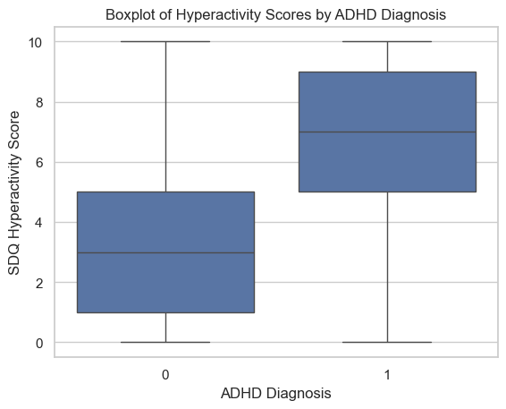
Exploratory Data Analysis 3. Hyperactivity score by study site (categorical data)

Slide 17
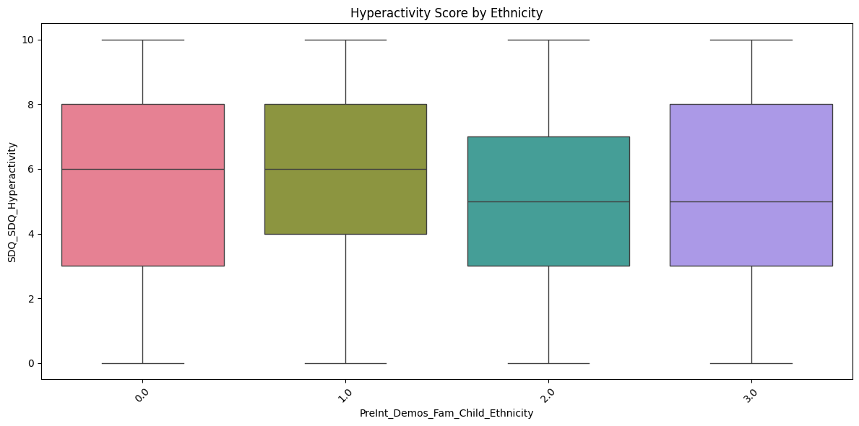
Exploratory Data Analysis 4. Hyperactivity score by study site (categorical data)

Slide 18
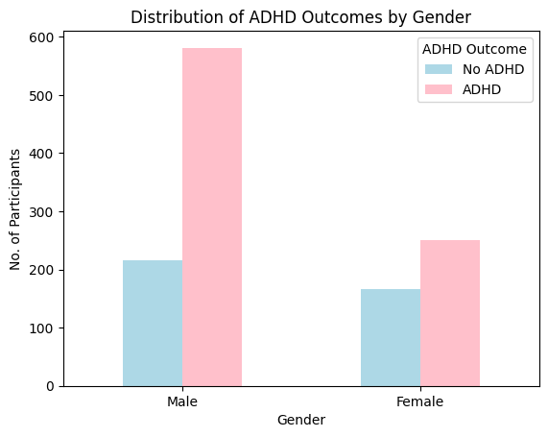
Exploratory Data Analysis 5. Distribution of ADHD Outcomes by Gender using Train dataset
This plot illustrates the distribution of ADHD diagnoses across genders. It highlights potential gender disparities in ADHD prevalence.

Slide 19
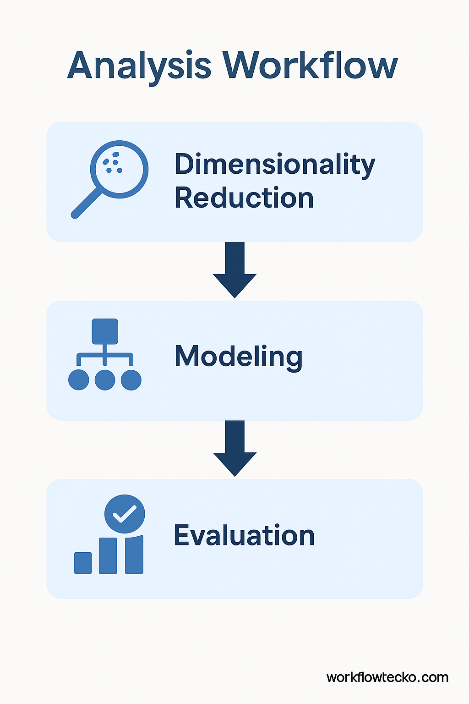
Strategy and Modeling
Dimensionality Reduction:
- Used Principal Component Analysis (PCA) and model-based feature selection to address dimensionality
Model-based feature selection
Modeling:
Used “MultiOutputClassifier” to predict ADHD and Sex simultaneously
Evaluation:
- Accuracy scores, classification reports used for validation

Slide 20
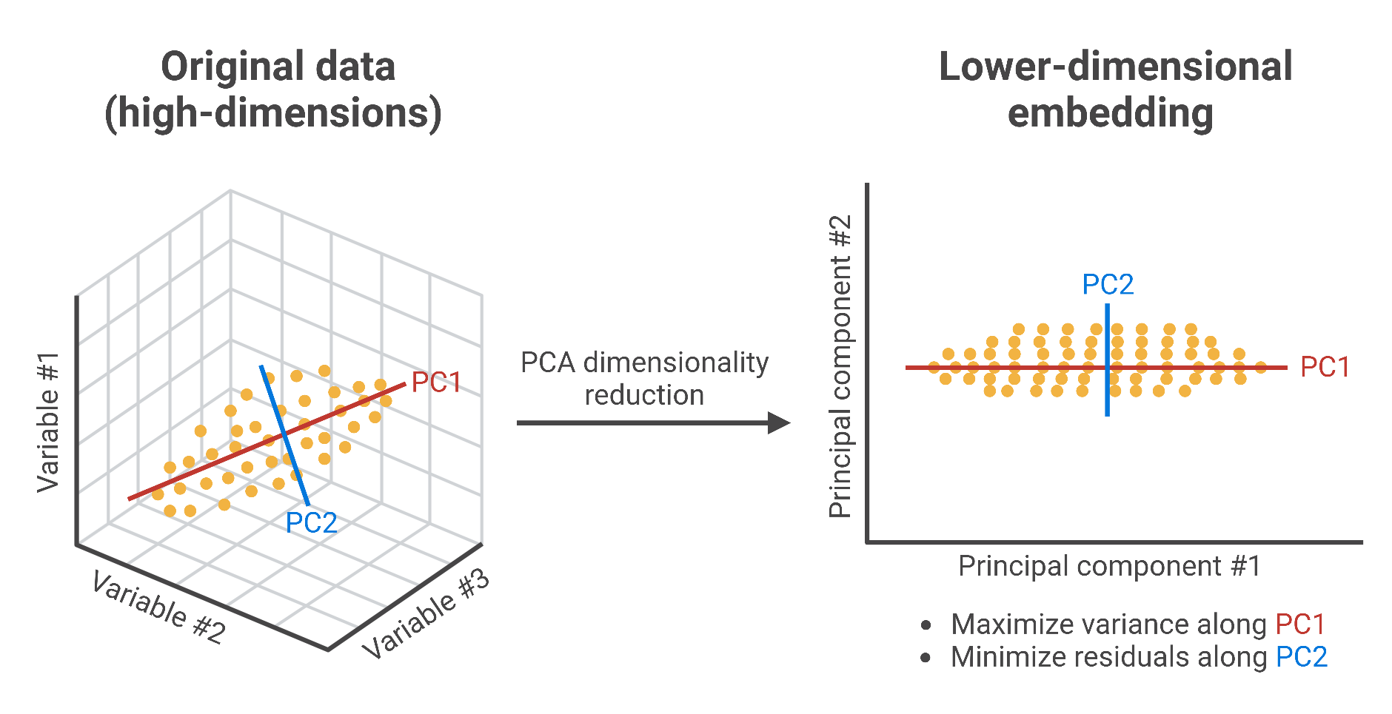
Principal Component Analysis(PCA)
Used to reduce dimensionality of high-dimensional data
Transforms features into uncorrelated principal components
The first few components capture most of the variance in the dataset
Applied before modeling to prevent overfitting and reduce noise
Trade-off: improves model performance but reduces interpretability of features

Slide 21
Model-based feature selection
How It Works ⚙️
Why We Used It ✅
Step | Description
1️⃣ Train a base model (e.g., Random Forest) | We train a classifier on all features to estimate importance
2️⃣ Rank features by importance | The model assigns a score to each feature based on how useful it was for making splits
3️⃣ Apply a threshold | We keep only features with importance above a certain threshold (e.g., > 0.005)
4️⃣ Re-train with selected features | The model is re-trained on this reduced feature set for better focus and generalization
Reason | Benefit
Improves generalization | Reduces noise from irrelevant or redundant features (especially helpful for Sex_F)
Reduces overfitting | Smaller models generalize better when data is limited
Speeds up training | Less input data means faster processing
Increases interpretability | Highlights which brain connections or metadata are informative

Slide 22
PCA vs. Model Feature Selection (Comparative Insights)
Aspect | PCA | Model-Based Feature Selection
What it does | Projects data into principal components | Selects top features using importance
Interpretability | Low (transformed features) | High (original features retained)
Performance | Moderate accuracy | Improved accuracy
Speed | Faster to apply | Slightly slower due to fitting

Slide 23
Multi-outcome modeling
MultiOutputClassifier
Reason | Benefit
🧠 Predict both labels simultaneously | Efficient, avoids separate preprocessing
🔁 Use the same base model for each target | Helps compare feature impact consistently
📦 Simplify model management and saving | One model = two outputs
Two binary outcome
Female
(0= no or 1= yes)
ADHD
(1=yes or 0=no)
**both targets are related to the same feature space (functional connectome + metadata)

Slide 24
Multi-outcome modeling
Model ✅ | Why We Chose It | Strengths
Random Forest | Default baseline for structured/tabular data | Nonlinear, handles missingness, robust to overfitting, interpretable feature importance
Logistic Regression | Interpretable linear model | Understands linear class separation; helps diagnose imbalance or weak signal
LightGBM | High-performance gradient boosting | Handles large features well, fast training, captures complex interactions
Model ❌ | Reason for Exclusion
Support vector machine | Does not scale well with high-dimensional data. Slow to train.
K-Nearest Neighbors | Struggles with high-dimensionality. Poor generalization.
Neural Networks | Requires more data and tuning; prone to overfitting on smaller tabular datasets.
XGBoost | Slower and more memory-intensive on large feature sets.
Naïve Bayes | Assumes feature independence; unrealistic for brain and behavioral data.

Slide 25
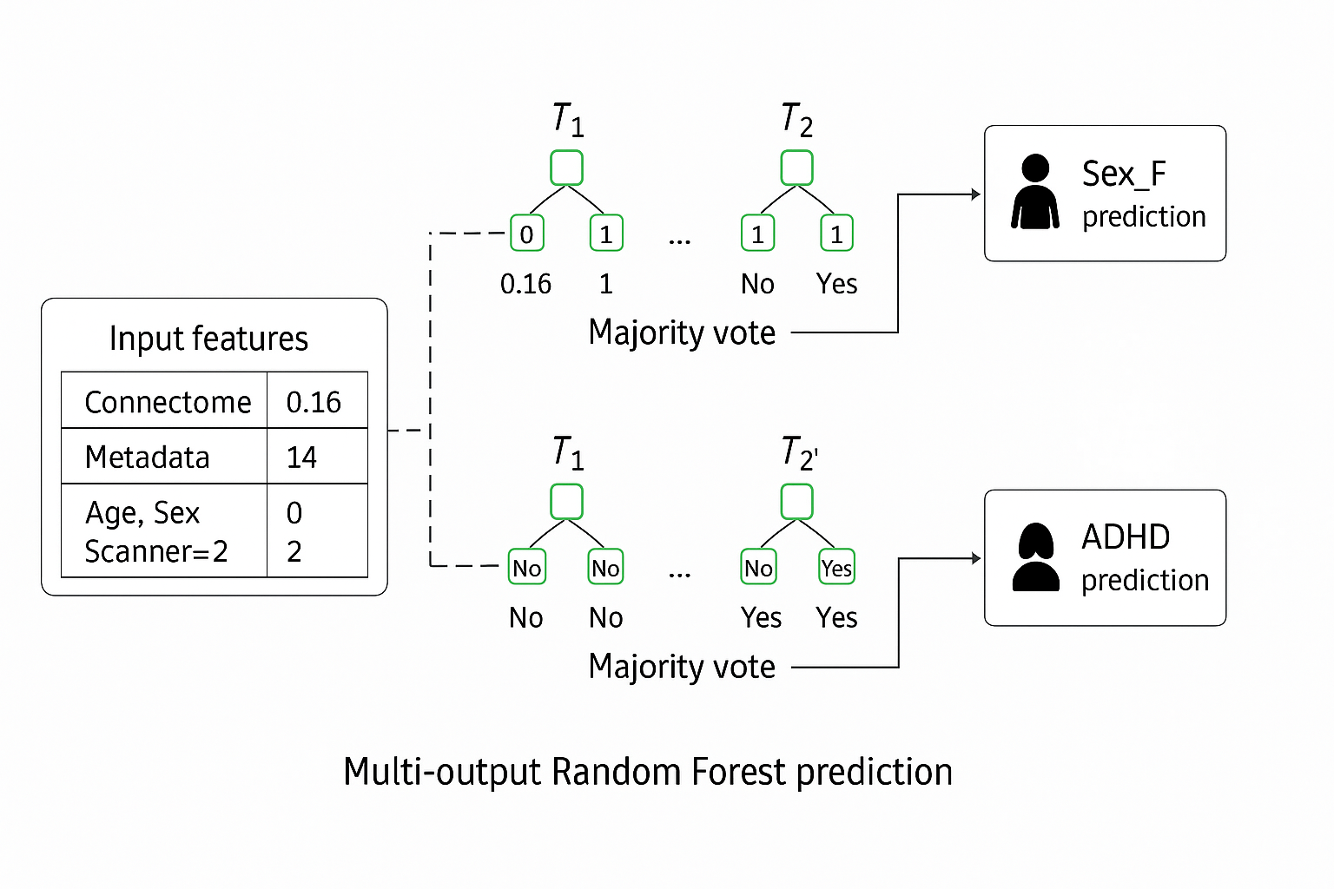
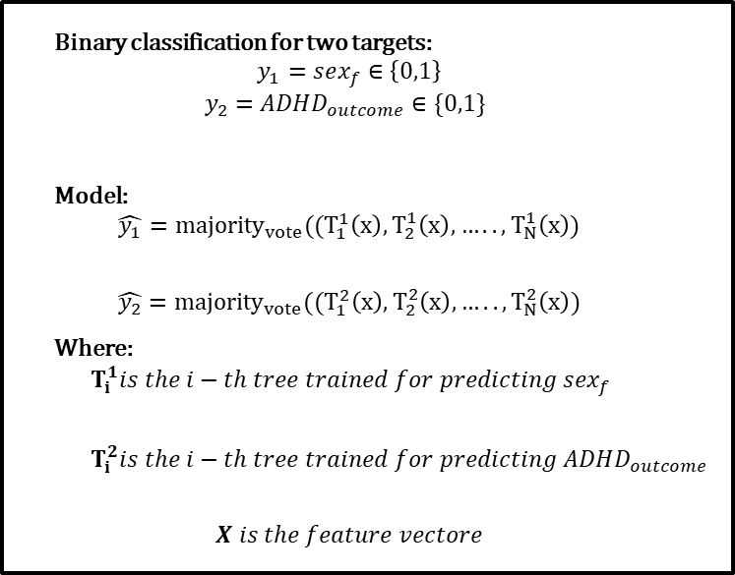
Random forest
Random Forest builds many diverse decision trees on different random samples of the data and aggregates their predictions
Binary classification for two targets:
$$y_{1}=sex_{f}∈\left\{0,1\right\}$$
$$y_{2}=ADHD_{outcome}∈\{0,1\}$$
Model:
$$\hat{y_{1}}={majority}_{vote}((T_{1}^{1}\left(x\right), T_{2}^{1}\left(x\right),…..,T_{N}^{1}\left(x\right))$$
$$\hat{y_{2}}={majority}_{vote}((T_{1}^{2}\left(x\right), T_{2}^{2}\left(x\right),…..,T_{N}^{2}\left(x\right))$$
Where:
$$T_{i}^{1}is the i−th tree trained for predicting sex_{f}$$
$$T_{i}^{2}is the i−th tree trained for predicting ADHD_{outcome}$$
$$X is the feature vectore$$

Slide 26
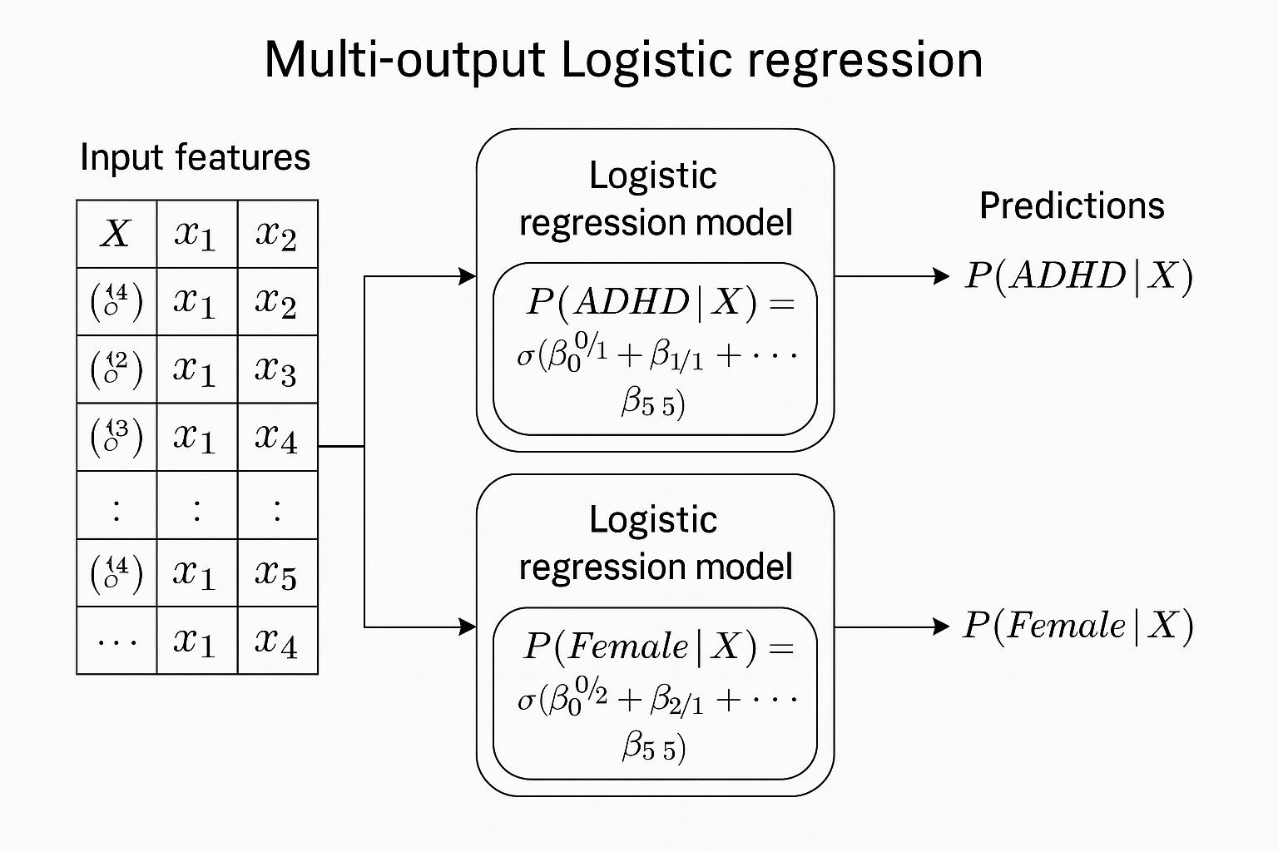
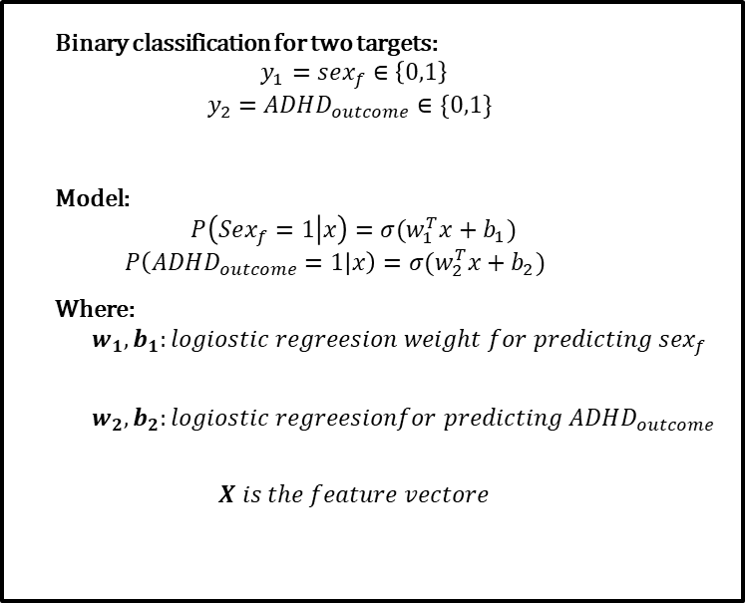
Logistic regression
Multi-output logistic regression models the probability of multiple binary target variables by fitting independent logistic regression equations to each, using the same set of input features.
Binary classification for two targets:
$$y_{1}=sex_{f}∈\left\{0,1\right\}$$
$$y_{2}=ADHD_{outcome}∈\{0,1\}$$
Model:
$$P\left(Sex_{f}=1 | x\right)=σ(w_{1}^{T}x+b_{1})$$
$$P\left(ADHD_{outcome}=1 | x\right)=σ(w_{2}^{T}x+b_{2})$$
Where:
$$w_{1}, b_{1}:logiostic regreesion weight for predicting sex_{f}$$
$$w_{2}, b_{2}:logiostic regreesionfor predicting ADHD_{outcome}$$
$$X is the feature vectore$$

Slide 27
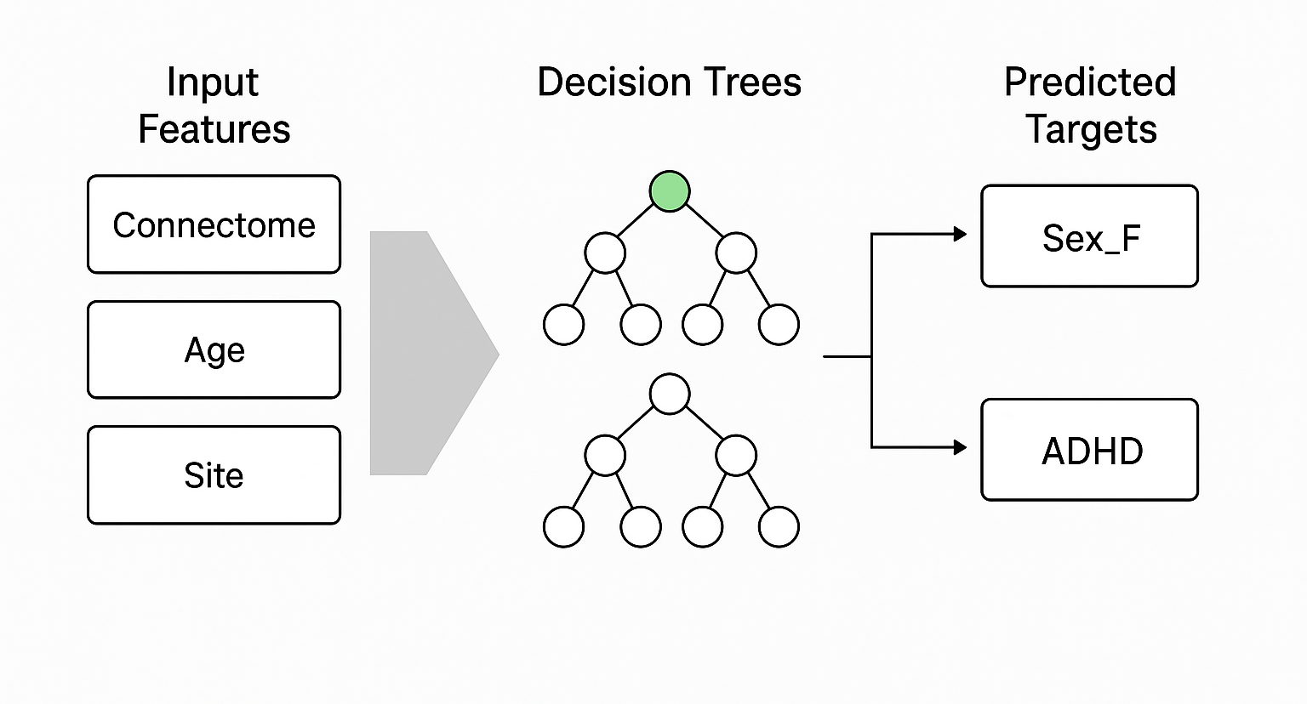
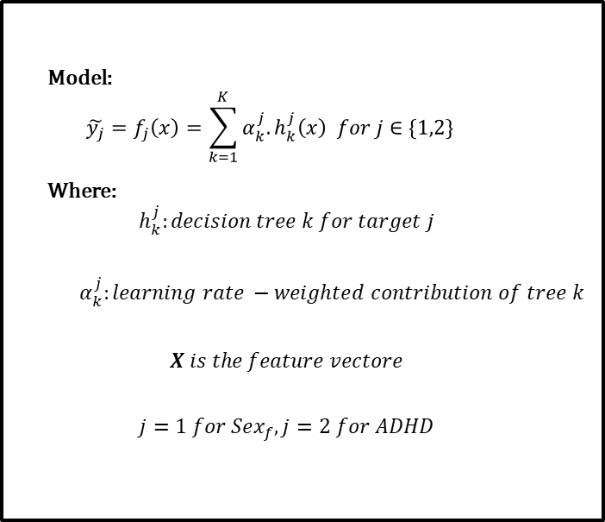
Gradient boosting
Multi-output LightGBM builds separate ensembles of trees for each target, enabling efficient and scalable prediction of multiple labels from the same feature set
Model:
$$\tilde{y_{j}}=f_{j}\left(x\right)=\sum_{k=1}^{K}{α_{k}^{j}.h_{k}^{j}\left(x\right) for j∈\{1,2\}}$$
Where:
$$h_{k}^{j}:decision tree k for target j$$
$$α_{k}^{j}:learning rate −weighted contribution of tree k$$
$$X is the feature vectore$$
$$j=1 for Sex_{f}, j=2 for ADHD$$

Slide 28
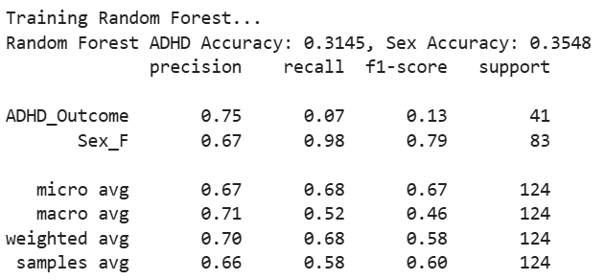
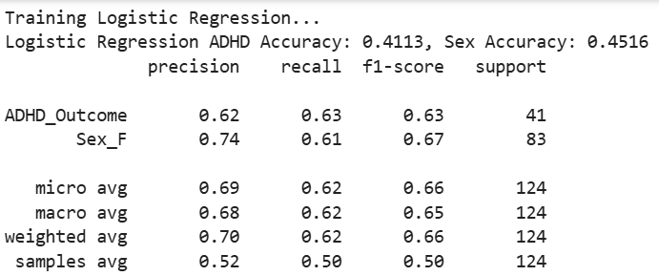
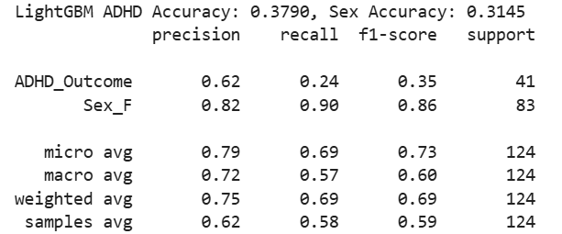
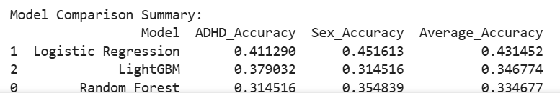
Model Development Phases
Phase 1: Simple training without imputation i.e., dropping all the rows having missing values

Slide 29
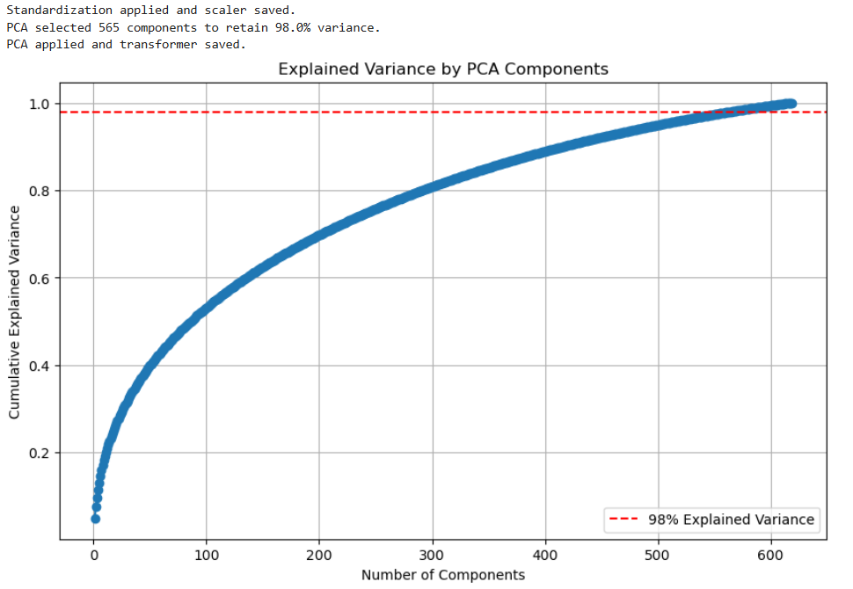
Model Development Phases
Phase 2: Dimensionality Reduction via PCA

Slide 30
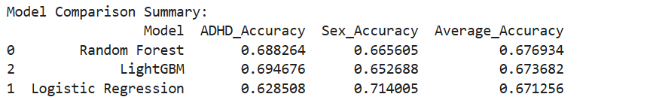
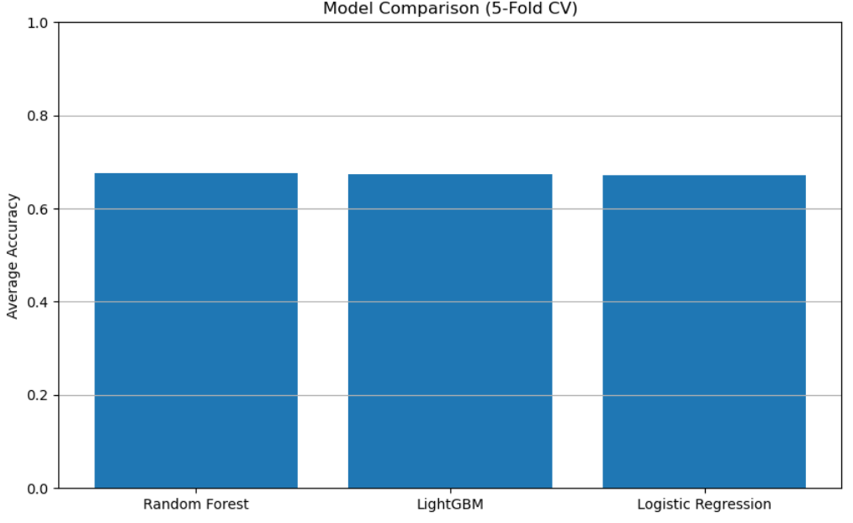
Model Development Phases
Phase 3: Model Definition and Cross-Validation

Slide 31
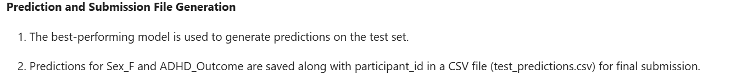
Model Development Phases
Phase 4: Test Data Loading, Preprocessing and Test Data Transformation
participant_id | Sex_F_predicted | ADHD_Outcome_predicted
Cfwaf5FX7jWK | 0 | 1
ULliyEXjy4OV | 0 | 1
LZfeAb1xMtql | 0 | 1
EnFOUv0YK1RG | 0 | 1
PRKZcnOgqcuk | 0 | 1
DuVUuyMZi5qV | 0 | 1
BpzyExrET5ta | 0 | 1
sAqeb6F4lz97 | 0 | 1
u7XOOvHirIx7 | 0 | 1

Slide 32
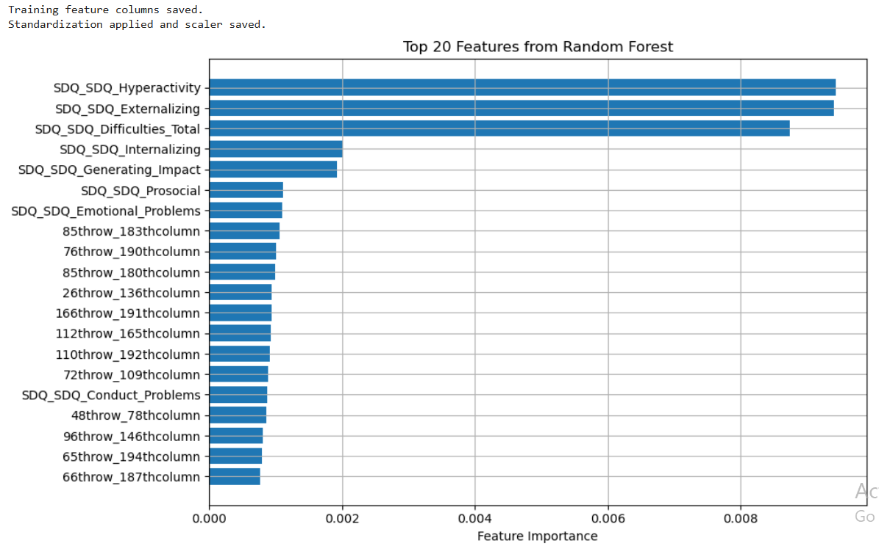
Model Development Phases
Phase 5: Model feature selection without imputation

Slide 33
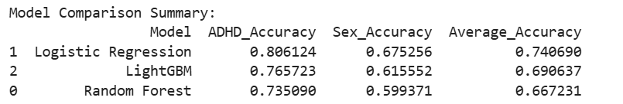
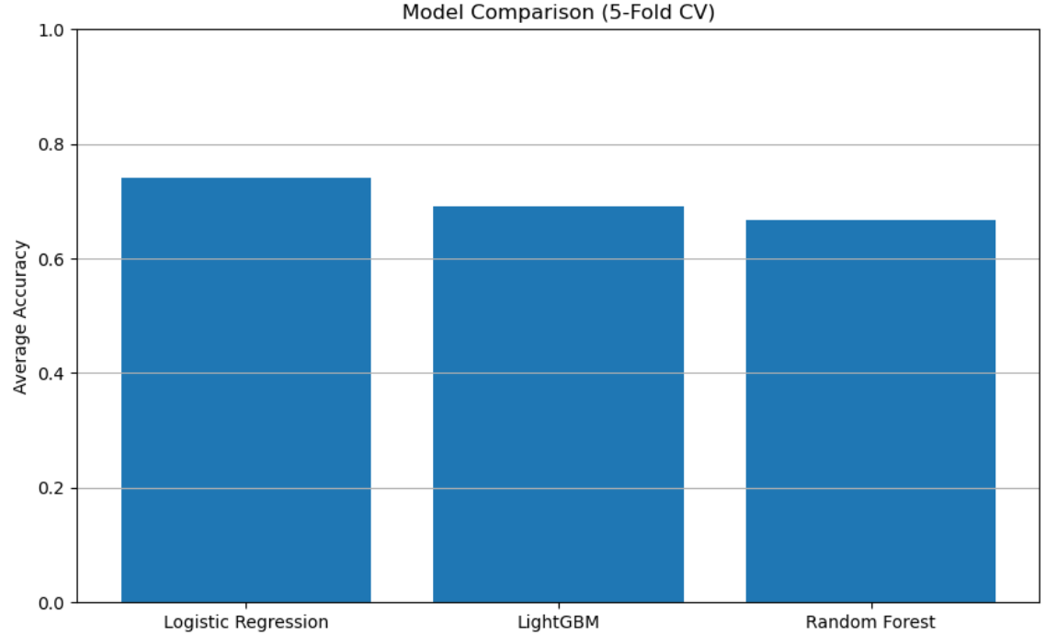
Model Development Phases
Phase 6 : Cross validation implemented for each model

Slide 34
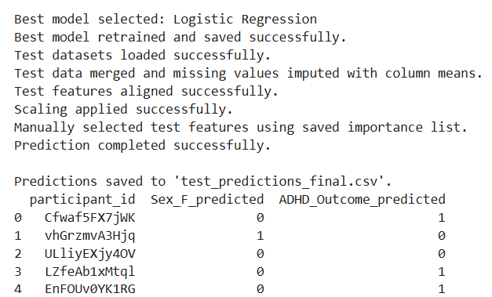
Model Development Phases
Phase 7: Test data loading, preprocessing, transformation and prediction
participant_id | Sex_F_predicted | ADHD_Outcome_predicted
Cfwaf5FX7jWK | 0 | 1
vhGrzmvA3Hjq | 1 | 0
ULliyEXjy4OV | 0 | 0
LZfeAb1xMtql | 0 | 1
EnFOUv0YK1RG | 0 | 1
3VbkvJ22j9Fu | 0 | 1
PRKZcnOgqcuk | 0 | 0
DuVUuyMZi5qV | 1 | 0
uM4etVLZrgMg | 0 | 1

Slide 35
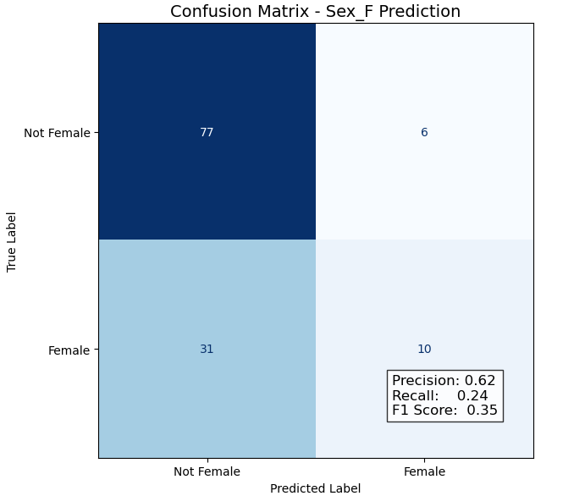
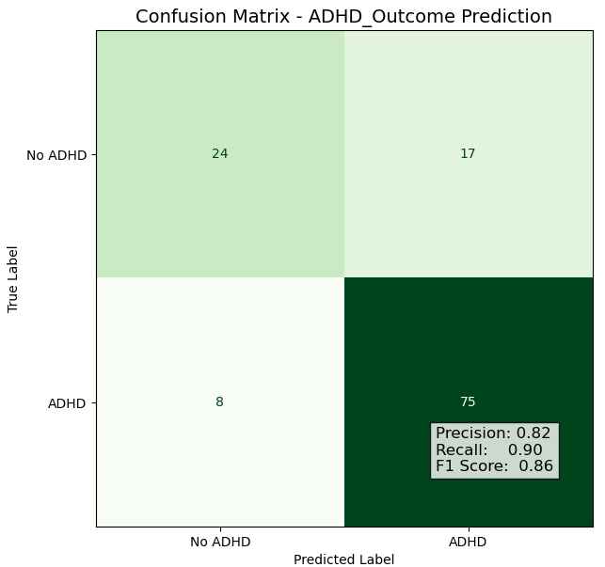
Model Development Phases
Phase 8: Confusion Matrix generation

Slide 36
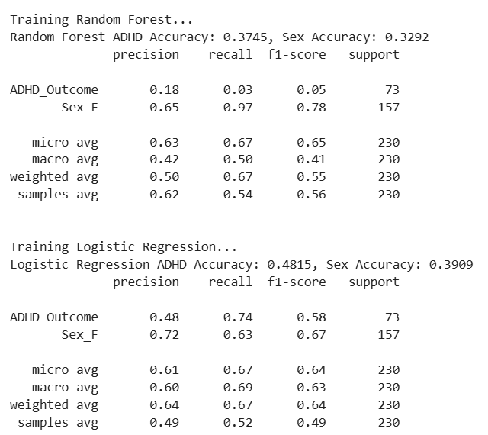
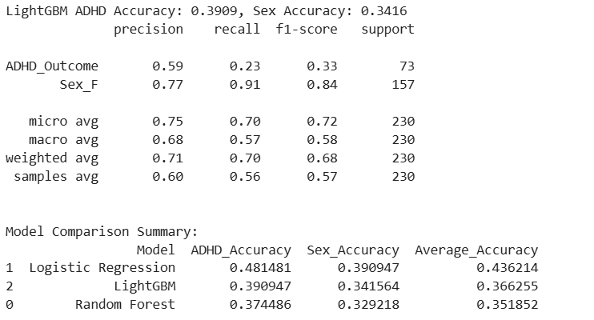
Model Development Phases
Phase 9: Simple training with imputation

Slide 37
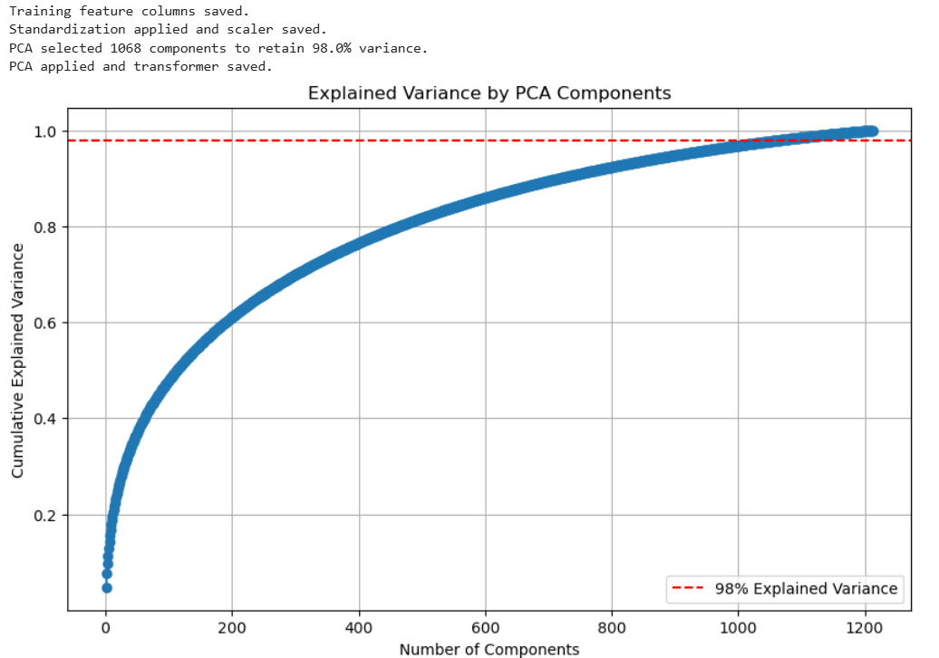
Model Development Phases
Phase 10: Dimensionality Reduction via PCA

Slide 38
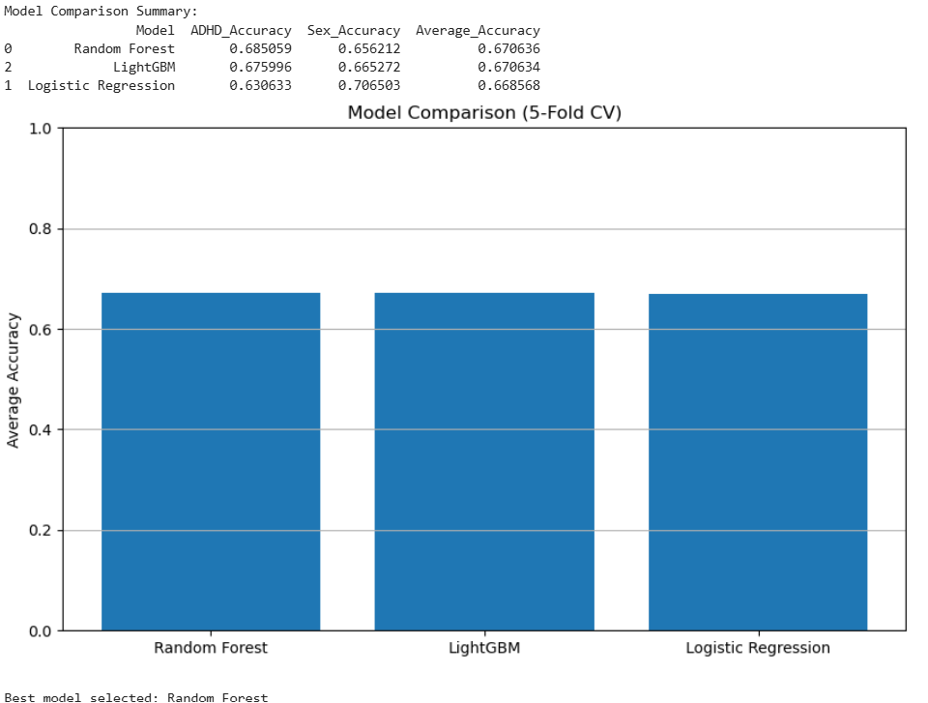
Model Development Phases
Phase 11: Model Definition and Cross-Validation

Slide 39
Model Development Phases
Phase 12: Test Data Loading, Preprocessing and Test Data Transformation (No difference)
participant_id | Sex_F_predicted | ADHD_Outcome_predicted
Cfwaf5FX7jWK | 0 | 1
ULliyEXjy4OV | 0 | 1
LZfeAb1xMtql | 0 | 1
EnFOUv0YK1RG | 0 | 1
PRKZcnOgqcuk | 0 | 1
DuVUuyMZi5qV | 0 | 1
BpzyExrET5ta | 0 | 1
sAqeb6F4lz97 | 0 | 1
u7XOOvHirIx7 | 0 | 1

Slide 40
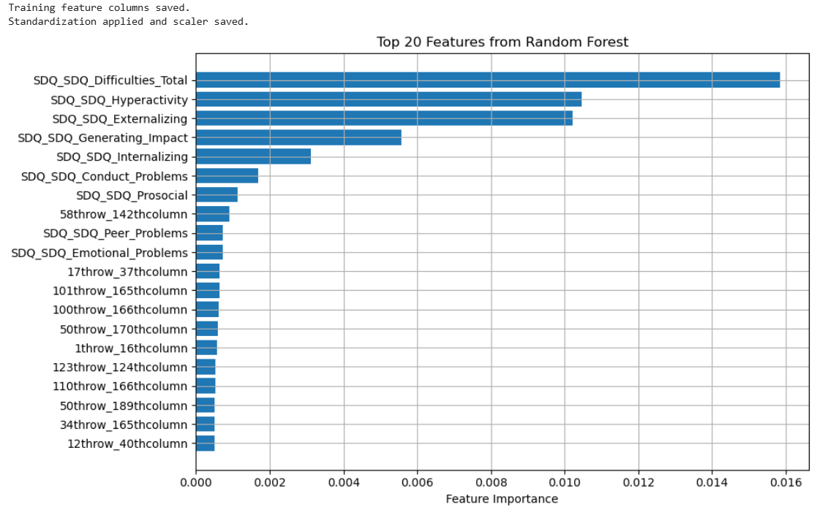
Model Development Phases
Phase 12: Model feature selection with imputation

Slide 41
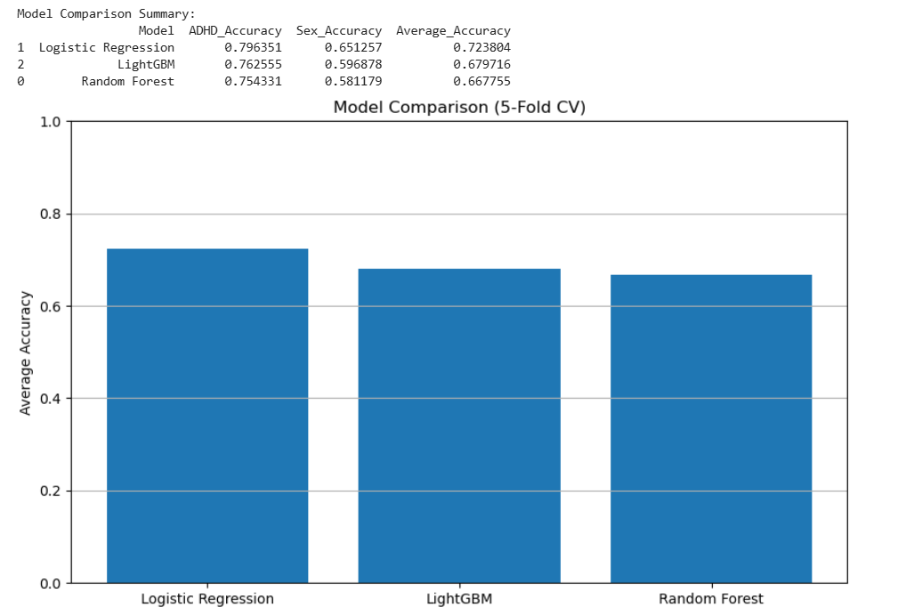
Model Development Phases
Phase 13 : Cross validation implemented for each model

Slide 42
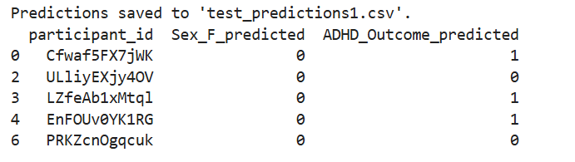
Model Development Phases
Phase 14: Test data loading, preprocessing, transformation and prediction
participant_id | Sex_F_predicted | ADHD_Outcome_predicted
Cfwaf5FX7jWK | 0 | 1
ULliyEXjy4OV | 0 | 0
LZfeAb1xMtql | 0 | 1
EnFOUv0YK1RG | 0 | 1
PRKZcnOgqcuk | 0 | 0
DuVUuyMZi5qV | 1 | 0
BpzyExrET5ta | 1 | 1
sAqeb6F4lz97 | 0 | 0
u7XOOvHirIx7 | 0 | 0

Slide 43
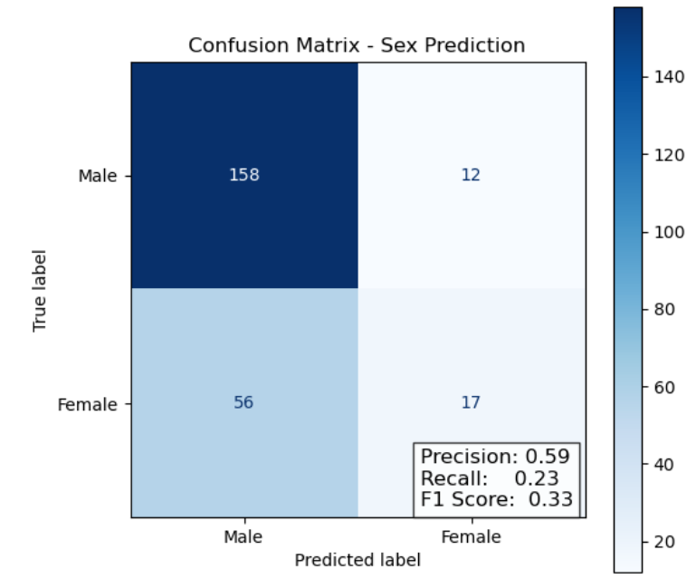
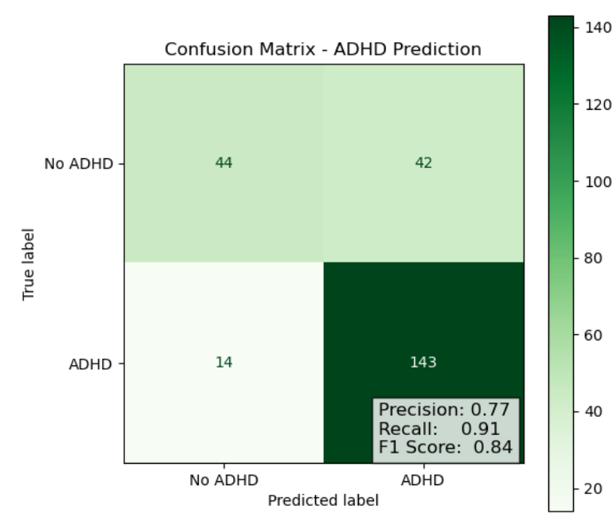
Model Development Phases
Phase 15: Confusion Matrix generation

Slide 44

Thank you!
Any question?
Codes used for this project: https://github.com/panditpooja/WiDS_Datathon_2025
Email us: parthav@arizona.edu poojapandit@arizona.edu nehaschaudhari02@arizona.edu mushaerahmed@arizona.edu

Slide 45
Random forest
Random Forest builds many diverse decision trees on different random samples of your data and aggregates their predictions
**Step 1: Bootstrap Sampling** Each tree is trained on a random subset of participants (with replacement) → Tree 1: participants 1–100, Tree 2: 50–150, etc.
**Step 2: Feature Subsampling** Each split in a tree only considers a random subset of features → Tree 1 might use ['age', 'site', 'conn_14_92'], Tree 2 uses ['conn_5_33', 'iq_score'], etc.
**Step 3: Tree Training** Each tree learns different patterns independently → One tree might learn: if conn_10_23 > 0.3 → ADHD = 1.
**Step 4: Aggregation (Voting)** Final prediction = majority vote from all trees → If 70/100 trees predict ADHD = 1 → output = ADHD = 1.

Slide 46

Model Development Problem Overview
Goal: Build a model to predict both ADHD diagnosis (binary) and sex (binary) using brain and behavioral data
Data Source: Healthy Brain Network, ~1200 subjects for training, ~300 for testing
Inputs: fMRI connectome, socio-demographics, emotions, parenting in form of quantitative and categorical data format
Outputs: ADHD_Outcome (0/1), Sex_F (0/1)

